Slide 1
Chapter 6
Human Aspects of Software Engineering
Slide Set to accompany Software Engineering: A Practitioner’s Approach, 8/e
by Roger S. Pressman and Bruce R. Maxim
Slides copyright © 1996, 2001, 2005, 2009, 2014 by Roger S. Pressman
For non-profit educational use only
May be reproduced ONLY for student use at the university level when used in conjunction with Software Engineering: A Practitioner's Approach, 8/e. Any other reproduction or use is prohibited without the express written permission of the author.
All copyright information MUST appear if these slides are posted on a website for student use.

Slide 2
Traits of Successful Software Engineers
Sense of individual responsibility
Acutely aware of the needs of team members and stakeholders
Brutally honest about design flaws and offers constructive criticism
Resilient under pressure
Heightened sense of fairness
Attention to detail
Pragmatic

Slide 3
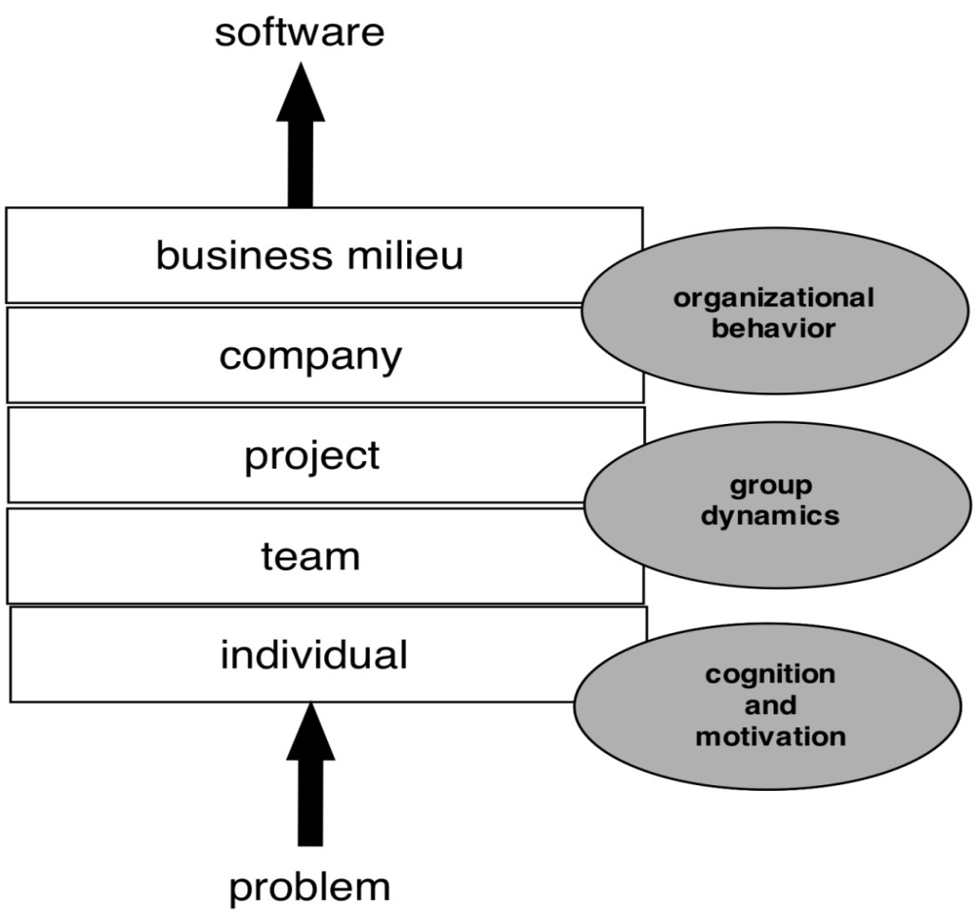
Behavioral Model for Software Engineering

Slide 4
Effective Software Team Attributes
Sense of purpose
Sense of involvement
Sense of trust
Sense of improvement
Diversity of team member skill sets

Slide 5
Avoid Team “Toxicity”
A frenzied work atmosphere in which team members waste energy and lose focus on the objectives of the work to be performed.
High frustration caused by personal, business, or technological factors that cause friction among team members.
“Fragmented or poorly coordinated procedures” or a poorly defined or improperly chosen process model that becomes a roadblock to accomplishment.
Unclear definition of roles resulting in a lack of accountability and resultant finger-pointing.
“Continuous and repeated exposure to failure” that leads to a loss of confidence and a lowering of morale.

Slide 6
Factors Affecting Team Structure
The following factors must be considered when selecting a software project team structure ...
the difficulty of the problem to be solved
the size of the resultant program(s) in lines of code or function points
the time that the team will stay together (team lifetime)
the degree to which the problem can be modularized
the required quality and reliability of the system to be built
the rigidity of the delivery date
the degree of sociability (communication) required for the project

Slide 7
Organizational Paradigms
closed paradigm—structures a team along a traditional hierarchy of authority
random paradigm—structures a team loosely and depends on individual initiative of the team members
open paradigm—attempts to structure a team in a manner that achieves some of the controls associated with the closed paradigm but also much of the innovation that occurs when using the random paradigm
synchronous paradigm—relies on the natural compartmentalization of a problem and organizes team members to work on pieces of the problem with little active communication among themselves
suggested by Constantine [Con93]

Slide 8
Generic Agile Teams
Stress individual competency coupled with group collaboration as critical success factors
Agile teams as self-organizing and have many structures
An adaptive team structure
Uses elements of Constantine’s random, open, and synchronous structures
Significant autonomy
Planning is kept to a minimum and constrained only by business requirements and organizational standards

Slide 9
XP Team Values
Communication – close informal verbal communication among team members and stakeholders and establishing as part of continuous feedback
Simplicity – design for immediate needs
Feedback – derives from the implemented software, the customer, and other team members
Courage – the discipline to resist pressure to design for unspecified future requirements
Respect – among team members and stakeholders

Slide 10
Impact of Social Media
Blogs – can be used share information with team members and customers
Microblogs (e.g. Twitter) – allow posting of real-time messages to individuals following the poster
Targeted on-line forums – allow participants to post questions or opinions and collect answers
Social networking sites (e.g. Facebook, LinkedIn) – allows connections among software developers for the purpose of sharing information
Social book marking (e.g. Delicious, Stumble, CiteULike) – allow developers to keep track of and share web-based resources

Slide 11
Software Engineering using the Cloud
Benefits
Provides access to all software engineering work products
Removes device dependencies and available every where
Provides avenues for distributing and testing software
Allows software engineering information developed by one member to be available to all team members
Concerns
Dispersing cloud services outside the control of the software team may present reliability and security risks
Potential for interoperability problems becomes high with large number of services distributed on the cloud
Cloud services stress usability and performance which often conflicts with security, privacy, and reliability

Slide 12
Collaboration Tools
Namespace that allows secure, private storage or work products
Calendar for coordinating project events
Templates that allow team members to create artifacts that have common look and feel
Metrics support to allow quantitative assessment of each team member’s contributions
Communication analysis to track messages and isolates patterns that may imply issues to resolve
Artifact clustering showing work product dependencies

Slide 13
Team Decisions Making Complications
Problem complexity
Uncertainty and risk associated with the decision
Work associated with decision has unintended effect on another project object (law of unintended consequences)
Different views of the problem lead to different conclusions about the way forward
Global software teams face additional challenges associated with collaboration, coordination, and coordination difficulties

Slide 14
More on Agile Teams

Slide 15
Scrum
Software company managers need information that will help them understand how much it costs to develop a software product, how long it will take and when the product can be brought to market.
Plan-driven development provides this information through long-term development plans that identify deliverables - items the team will deliver and when these will be delivered.
Plans always change so anything apart from short-term plans are unreliable.
Scrum is an agile method that provides a framework for agile project organization and planning. It does not mandate any specific technical practices.

Slide 16
Table 2.5 Scrum terminology (1 of 2)
Scrum term | Explanation
Product | The software product that is being developed by the Scrum team.
Product Owner | A team member who is responsible for identifying product features and attributes. The Product Owner reviews work done and helps to test the product.
Product backlog | A to-do list of items such as bugs, features, and product improvements that the Scrum team has not yet completed.
Development team | A small self-organizing team of five to eight people who are responsible for developing the product.
Sprint | A short period, typically two to four weeks, when a product increment is developed.
Scrum | A daily team meeting where progress is reviewed and work to be done that day is discussed and agreed.

Slide 17
Table 2.5 Scrum terminology (2 of 2)
Scrum term | Explanation
ScrumMaster | A team coach who guides the team in the effective use of Scrum.
Potentially shippable product increment | The output of a sprint that is of high enough quality to be deployed for customer use.
Velocity | An estimate of how much work a team can do in a single sprint.

Slide 18
Key roles in Scrum (1 of 2)
The Product Owner is responsible for ensuring that the development team members are always focused on the product they are building rather than diverted into technically interesting but less relevant work.
In product development, the product manager should normally take on the Product Owner role.

Slide 19
Key roles in Scrum (2 of 2)
The ScrumMaster is a Scrum expert whose job is to guide the team in the effective use of the Scrum method. The developers of Scrum emphasize that the ScrumMaster is not a conventional project manager but is a coach for the team. They have authority within the team on how Scrum is used.
In many companies that use Scrum, the ScrumMaster also has some project management responsibilities.

Slide 20
Scrum and sprints
In Scrum, software is developed in sprints, which are fixed-length periods (2 - 4 weeks) in which software features are developed and delivered.
During a sprint, the team has daily meetings (Scrums) to review progress and to update the list of work items that are incomplete.
Sprints should produce a ‘shippable product increment’. This means that the developed software should be complete and ready to deploy.

Slide 21
Figure 2.3
Scrum cycle

Slide 22
Figure 2.4
The top five benefits of using Scrum

Slide 23
Key Scrum practices
Product backlog This is a to-do list of items to be implemented that is reviewed and updated before each sprint.
Timeboxed sprints Fixed-time (2-4 week) periods in which items from the product backlog are implemented,
Self-organizing teams Self-organizing teams make their own decisions and work by discussing issues and making decisions by consensus.

Slide 24
Product backlogs
The product backlog is a list of what needs to be done to complete the development of the product.
The items on this list are called product backlog items (PBIs).
The product backlog may include a variety of different items such as product features to be implemented, user requests, essential development activities and desirable engineering improvements.
The product backlog should always be prioritized so that the items that be implemented first are at the top of the list.

Slide 25
Table 2.6 Examples of product backlog items
1. As a teacher, I want to be able to configure the group of tools that are available to individual classes. (feature) 2. As a parent, I want to be able to view my children’s work and the assessments made by their teachers. (feature) 3. As a teacher of young children, I want a pictorial interface for children with limited reading ability. (user request) 4. Establish criteria for the assessment of open source software that might be used as a basis for parts of this system. (development activity) 5. Refactor user interface code to improve understandability and performance. (engineering improvement) 6. Implement encryption for all personal user data. (engineering improvement)

Slide 26
Table 2.7 Product backlog item states
Heading | Description
Ready for consideration | These are high-level ideas and feature descriptions that will be considered for inclusion in the product. They are tentative so may radically change or may not be included in the final product.
Ready for refinement | The team has agreed that this is an important item that should be implemented as part of the current development. There is a reasonably clear definition of what is required. However, work is needed to understand and refine the item.
Ready for implementation | The PBI has enough detail for the team to estimate the effort involved and to implement the item. Dependencies on other items have been identified.

Slide 27
Figure 2.5
Product backlog activities

Slide 28
Timeboxed sprints
Products are developed in a series of sprints, each of which delivers an increment of the product or supporting software.
Sprints are short duration activities (1-4 weeks) and take place between a defined start and end date. Sprints are timeboxed, which means that development stops at the end of a sprint whether or not the work has been completed.
During a sprint, the team work on the items from the product backlog.

Slide 29
Figure 2.6
Benefits of using timeboxed sprints

Slide 30
Sprint activities (1 of 2)
Sprint planning Work items to be completed in that sprint are selected and, if necessary, refined to create a sprint backlog. This should not last more than a day at the beginning of the sprint.
Sprint execution The team work to implement the sprint backlog items that have been chosen for that sprint. If it is impossible to complete all of the sprint backlog items, the sprint is not extended. The unfinished items are returned to the product backlog and queued for a future sprint.

Slide 31
Sprint activities (2 of 2)
Sprint reviewing The work done in the sprint is reviewed by the team and (possibly) external stakeholders. The team reflect on what went well and what went wrong during the sprint with a view to improving their work process.

Slide 32
Figure 2.7
Sprint activities

Slide 33
Sprint planning (1 of 2)
Establish an agreed sprint goal
Sprint goals may be focused on software functionality, support or performance and reliability,.
Decide on the list of items from the product backlog that should be implemented
Create a sprint backlog.
This is a more detailed version of the product backlog that records the work to be done during the sprint

Slide 34
Figure 2.8
Sprint goals

Slide 35
Sprint planning (2 of 2)
In a sprint plan, the team decides which items in the product backlog should be implemented during that sprint.
Key inputs are the effort estimates associated with PBIs and the team’s velocity
The output of the sprint planning process is a sprint backlog.
The sprint backlog is a breakdown of PBIs to show the what is involved in implementing the PBIs chosen for that sprint.
During a sprint, the team have daily meetings (scrums) to coordinate their work.

Slide 36
Table 2.8 Scrums
A scrum is a short, daily meeting that is usually held at the beginning of the day. During a scrum, all team members share information, describe their progress since the previous day’s scrum, and present problems that have arisen and plans for the coming day. This means that everyone on the team knows what is going on and, if problems arise, can re-plan short-term work to cope with them. Scrum meetings should be short and focused. To dissuade team members from getting involved in long discussions, scrums are sometimes organized as “stand-up” meetings where there are no chairs in the meeting room. During a scrum, the sprint backlog is reviewed. Completed items are removed from it. New items may be added to the backlog as new information emerges. The team then decides who should work on sprint backlog items that day.

Slide 37
Agile activities
Scrum does not suggest the technical agile activities that should be used. However, there are two practices that should always be used in a sprint.
Test automation As far as possible, product testing should be automated. You should develop a suite of executable tests that can be run at any time.
Continuous integration Whenever anyone makes changes to the software components they are developing, these components should be immediately integrated with other components to create a system. This system should then be tested to check for unanticipated component interaction problems.

Slide 38
Table 2.9 Code completeness checklist
State | Description
Reviewed | The code has been reviewed by another team member who has checked that it meets agreed coding standards, is understandable, includes appropriate comments, and has been refactored if necessary.
Unit tested | All unit tests have been run automatically and all tests have executed successfully.
Integrated | The code has been integrated with the project codebase and no integration errors have been reported.
Integration tested | All integration tests have been run automatically and all tests have been executed successfully.
Accepted | Acceptance tests have been run if appropriate and the Product Owner or the development team has confirmed that the product backlog item has been completed.

Slide 39
Sprint reviews (1 of 2)
At the end of each sprint, there is a review meeting, which involves the whole team. This meeting:
reviews whether or not the sprint has met its goal.
sets out any new problems and issues that have emerged during the sprint.
is a way for a team to reflect on how they can improve the way they work.

Slide 40
Sprint reviews (2 of 2)
The product owner has the ultimate authority to decide whether or not the goal of the sprint has been achieved. They should confirm that the implementation of the selected product backlog items is complete.
The sprint review should include a process review, in which the team reflects on its own way of working and how Scrum has been used.
The aim is to identify ways to improve and to discuss how to use Scrum more productively.

Slide 41
Figure 2.9
Self-organizing teams

Slide 42
Team size and composition (1 of 2)
The ideal Scrum team size is between 5 and 8 people.
Teams have to tackle diverse tasks and so usually require people with different skills, such as networking, user experience, database design and so on.
They usually involve people with different levels of experience.
A team of 5-8 people is large enough to be diverse yet small enough to communicate informally and effectively and to agree on the priorities of the team.

Slide 43
Team size and composition (2 of 2)
The advantage of a self-organizing team is that it can be a cohesive team that can adapt to change.
Because the team rather than individuals take responsibility for the work, they can cope with people leaving and joining the team.
Good team communication means that team members inevitably learn something about each other’s areas

Slide 44
Team coordination (1 of 2)
The developers of Scrum assumed that teams would be co-located. They would work in the same room and could communicate informally.
Daily scrums mean that the team members know what’s been done and what others are doing.

Slide 45
Team coordination (2 of 2)
However, the use of daily scrums as a coordination mechanism is based on two assumptions that are not always correct:
Scrum assumes that the team will be made up of full-time workers who share a workspace. In reality, team members may be part-time and may work in different places. For a student project team, the team members may take different classes at different times.
Scrum assumes that all team members can attend a morning meeting to coordinate the work for the day. However, some team members may work flexible hours (e.g. because of childcare responsibilities) or may work on several projects at the same time.

Slide 46
External interactions
External interactions are interactions that team members have with people outside of the team.
In Scrum, the idea is that developers should focus on development and only the ScrumMaster and Product Owner should be involved in external interactions.
The intention is that the team should be able to work on software development without external interference or distractions.

Slide 47
Figure 2.10
Managing external interactions

Slide 48
Project management (1 of 2)
In all but the smallest product development companies, there is a need for development teams to report on progress to company management.
A self-organizing team has to appoint someone to take on these responsibilities.
Because of the need to maintain continuity of communication with people outside of the group, rotating these activities around team members is not a viable approach.

Slide 49
Project management (2 of 2)
The developers of Scrum did not envisage that the ScrumMaster should also have project management responsibilities.
In many companies, however, the ScrumMaster has to take on project management responsibilities.
They know the work going on and are in the best position to provide accurate information and project plans and progress.

Slide 50
Figure 2.11
Project management responsibilities

Slide 51
Key points 1 (1 of 2)
The best way to develop software products is to use agile software engineering methods that are geared to rapid product development and delivery.
Agile methods are based around iterative development and the minimization of overheads during the development process.
Extreme programming (XP) is an influential agile method that introduced agile development practices such as user stories, test-first development and continuous integration. These are now mainstream software development activities.

Slide 52
Key points 1 (2 of 2)
Scrum is an agile method that focuses on agile planning and management. Unlike XP, it does not define the engineering practices to be used. The development team may use any technical practices that they believe are appropriate for the product being developed.
In Scrum, work to be done is maintained in a product backlog – a list of work items to be completed. Each increment of the software implements some of the work items from the product backlog.

Slide 53
Key points 2
Sprints are fixed-time activities (usually 2–4 weeks) where a product increment is developed. Increments should be ‘potentially shippable’ i.e. they should not need further work before they are delivered.
A self-organizing team is a development team that organizes the work to be done by discussion and agreement amongst team members.
Scrum practices such as the product backlog, sprints and self-organizing teams can be used in any agile development process, even if other aspects of Scrum are not used.

Slide 54

Copyright
This work is protected by United States copyright laws and is provided solely for the use of instructors in teaching their courses and assessing student learning. Dissemination or sale of any part of this work (including on the World Wide Web) will destroy the integrity of the work and is not permitted. The work and materials from it should never be made available to students except by instructors using the accompanying text in their classes. All recipients of this work are expected to abide by these restrictions and to honor the intended pedagogical purposes and the needs of other instructors who rely on these materials.

